Slide 1



Biodiversity data and analyses
Masterclass: Big data biogeography
Berlin, 04th – 8th November 2019
Physalia courses
Alexander Zizka & Daniele Silvestro

Slide 2






Biodiversity data and analyses
1. Download
2. Cleaning
3. Bias
Rgbif
4. Richness maps
PaleobioDB
7. Biome classification
6. Bioregionalization
5. Range size & conservation assessment
ConR

Slide 3
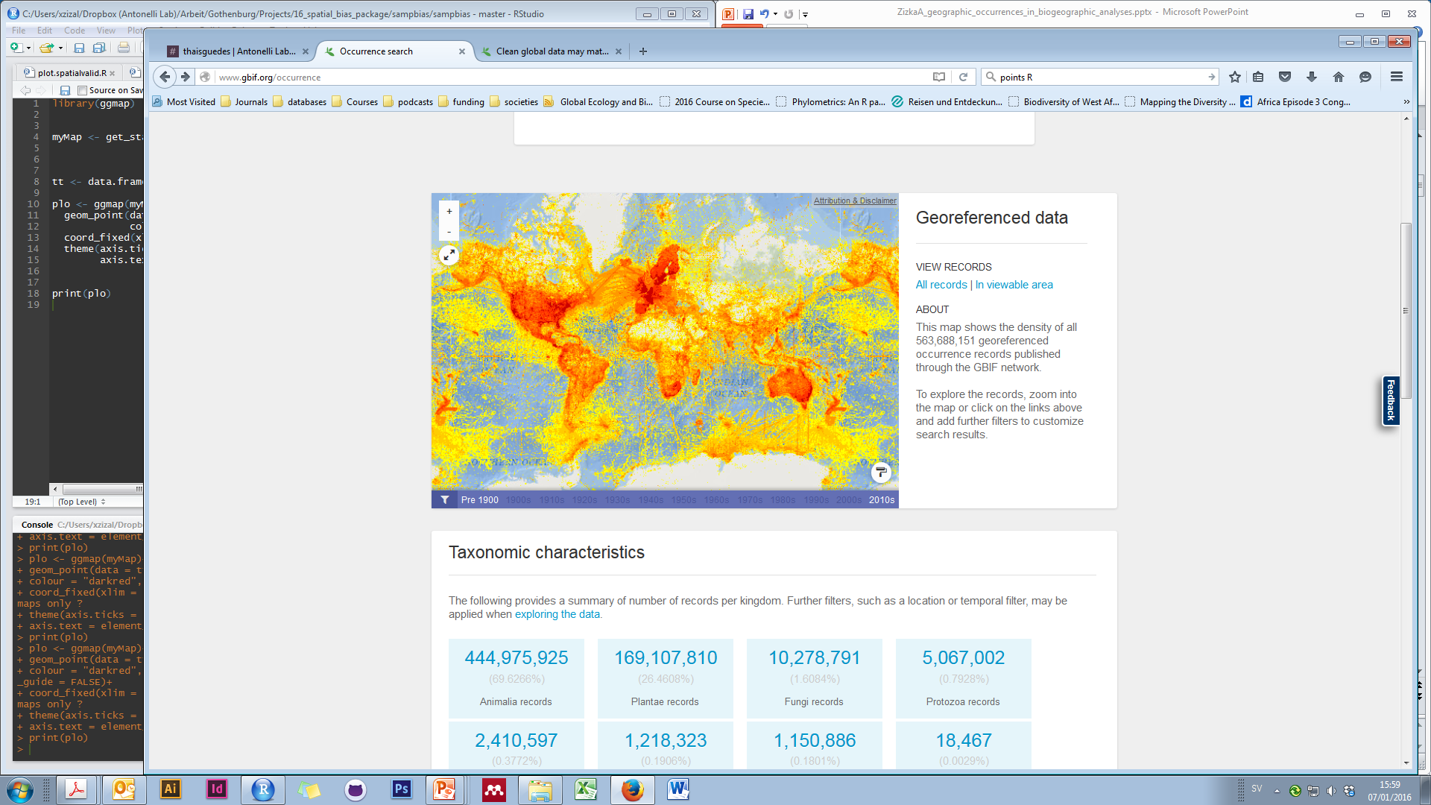
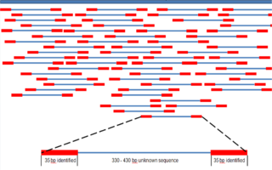
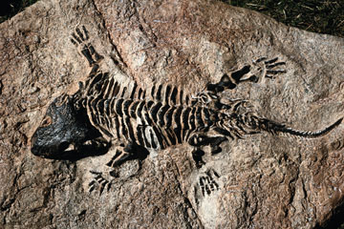
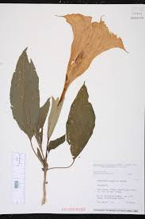
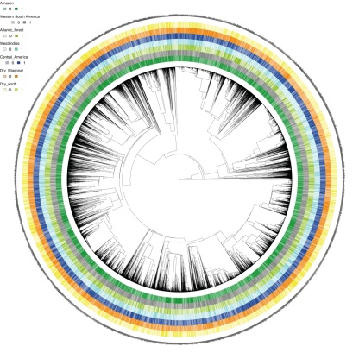
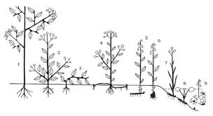
Understanding biodiversity
Distribution
DNA
Fossils
Traits
Taxonomy
Phylogenies

Slide 4
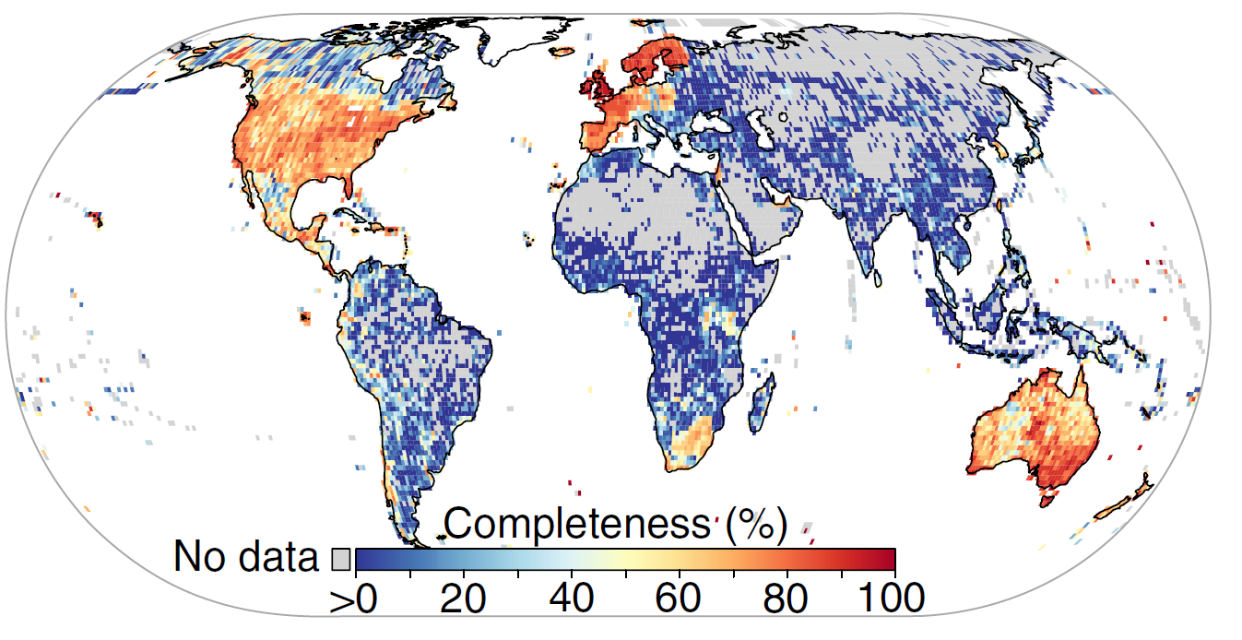
Biodiversity data – the Wallacean shortfall
“The geographic distribution of most species is still poorly known.”
Notes:
Due to sampling biases
40 % of Amazonia never been sampled

Slide 5

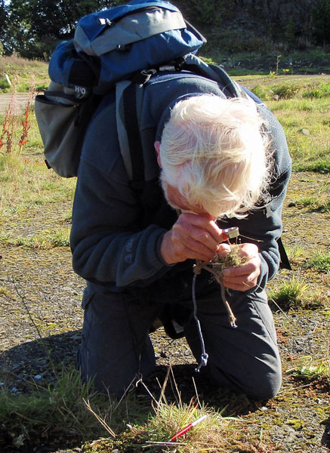
Collecting species occurrence records

Slide 6
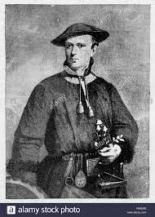
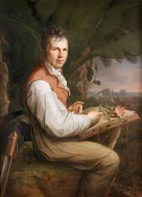
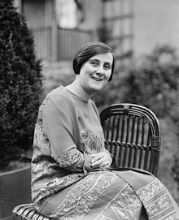
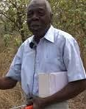
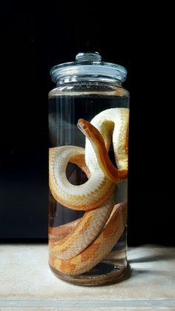
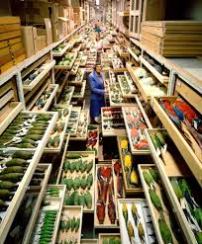
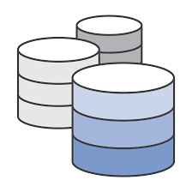

Slide 7
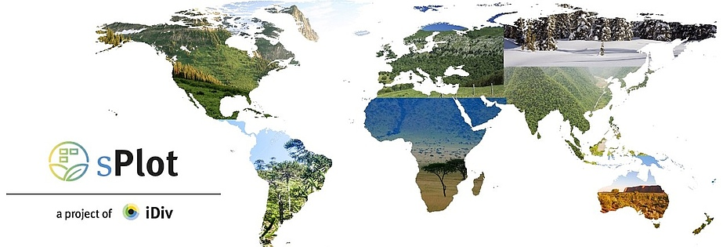


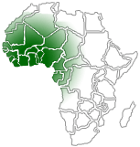








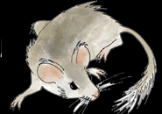
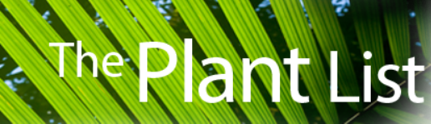

Biodiversity databases
Notes:
Who knows or ahs used any of these database? Which one?

Slide 8
Databases
www.gbif.org
http://www.iucnredlist.org/
www.paleobiodb.org

Slide 9
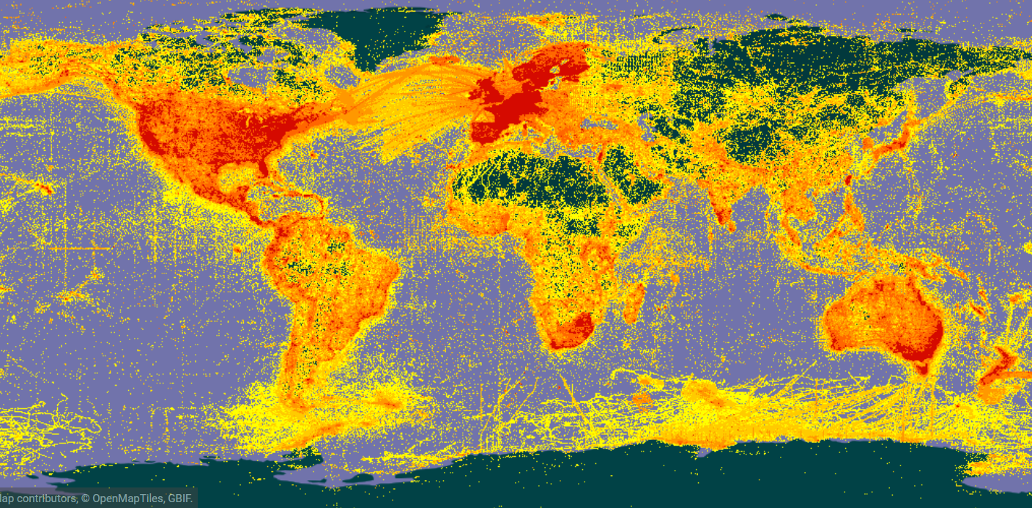
Global Biodiversity Information Facility (GBIF)
> 1,300,000,000 records
Notes:
Who is familiar with GBIF

Slide 10
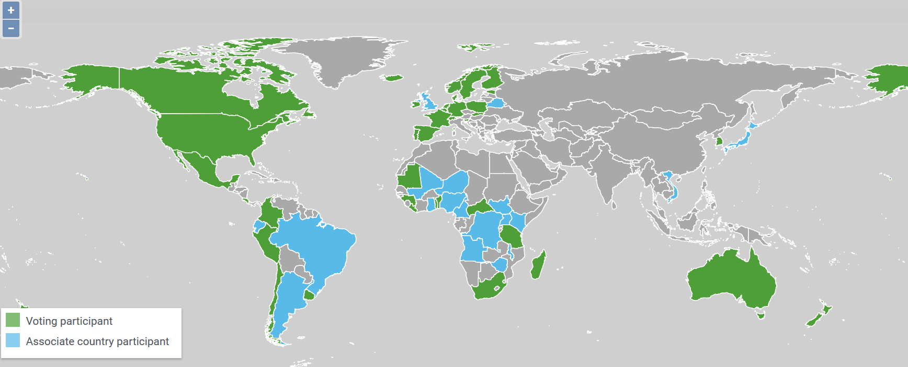
What is GBIF?

Slide 11
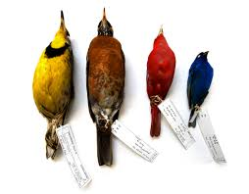
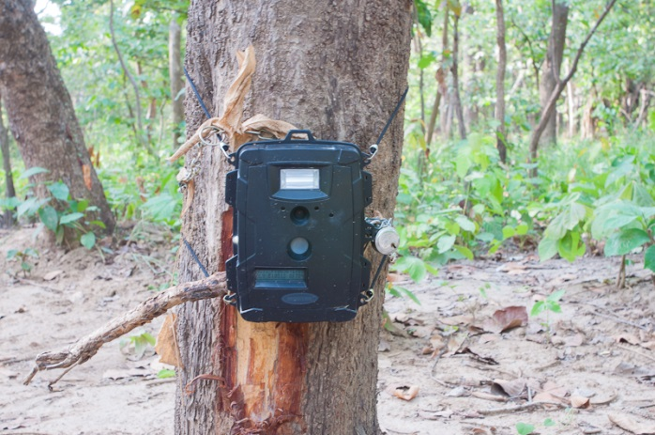
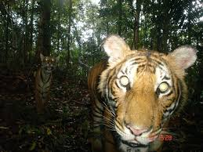

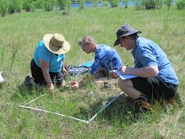
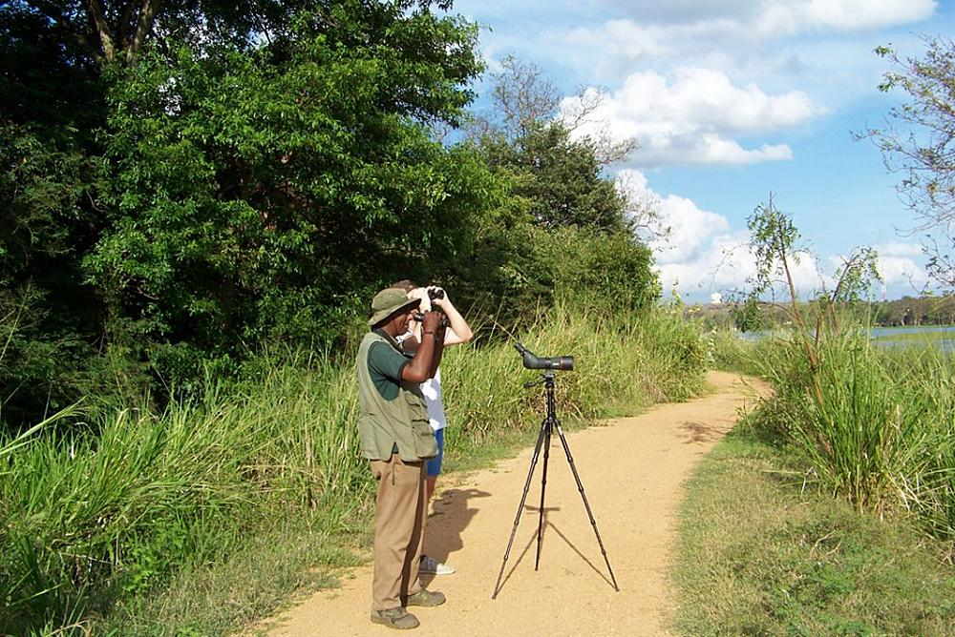
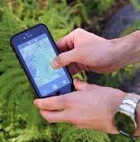
Data in GBIF?

Slide 12
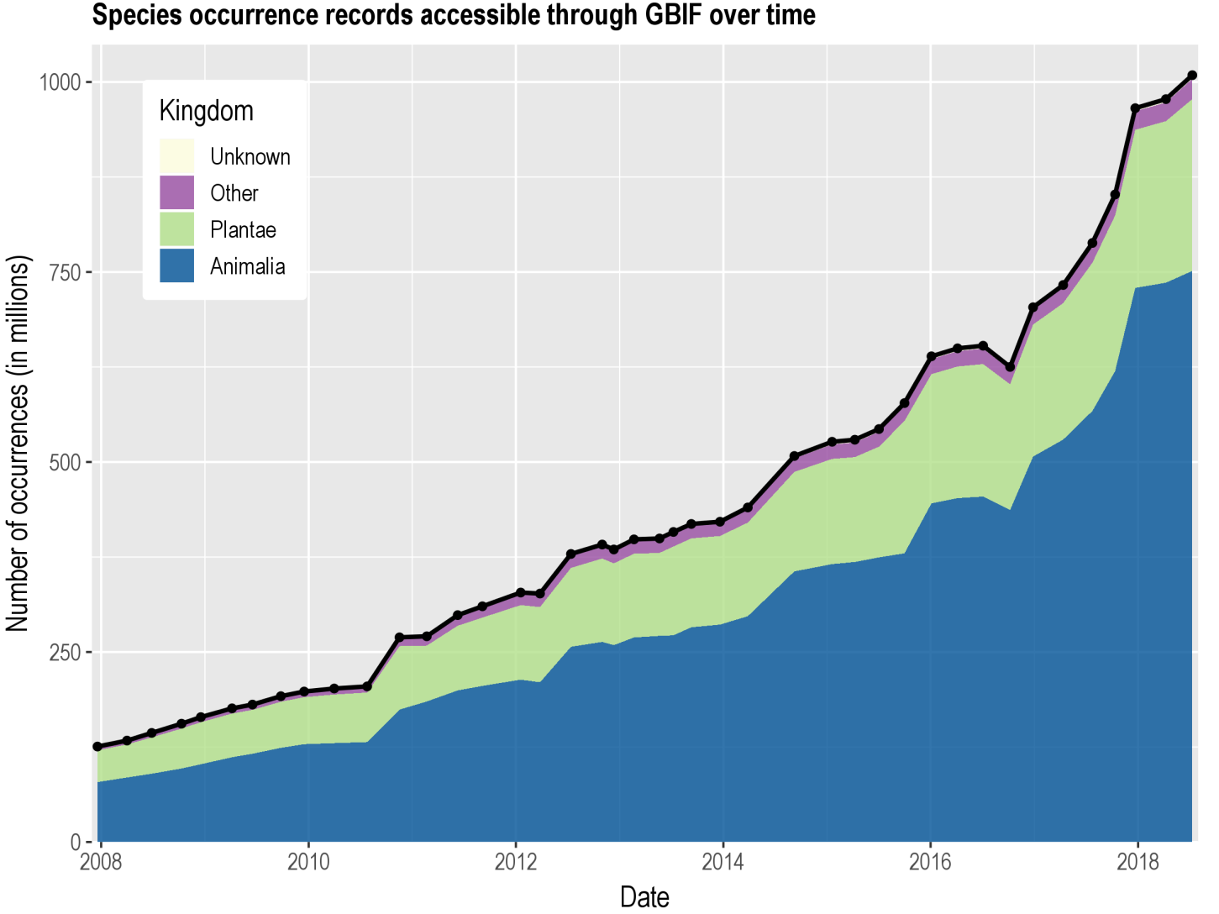
Records

Slide 13
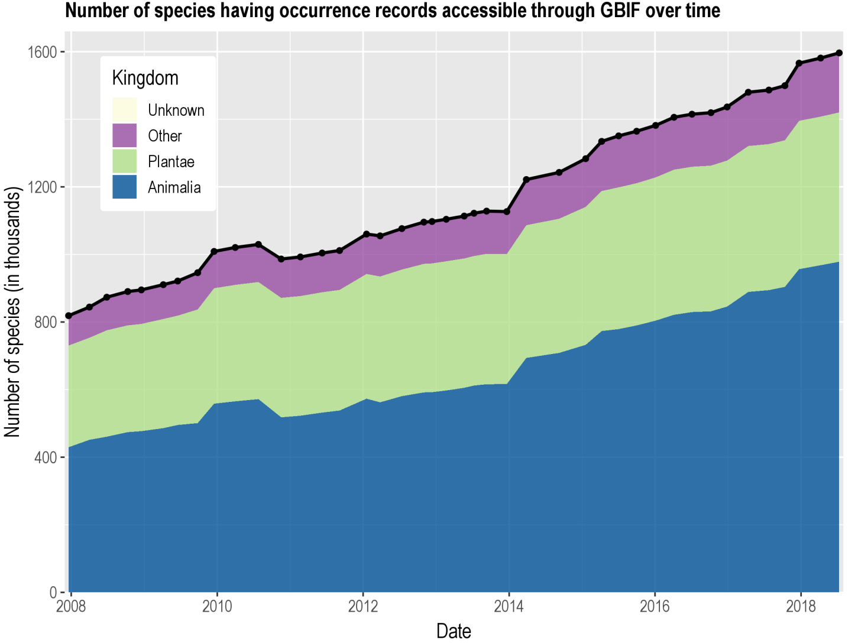
Species

Slide 14
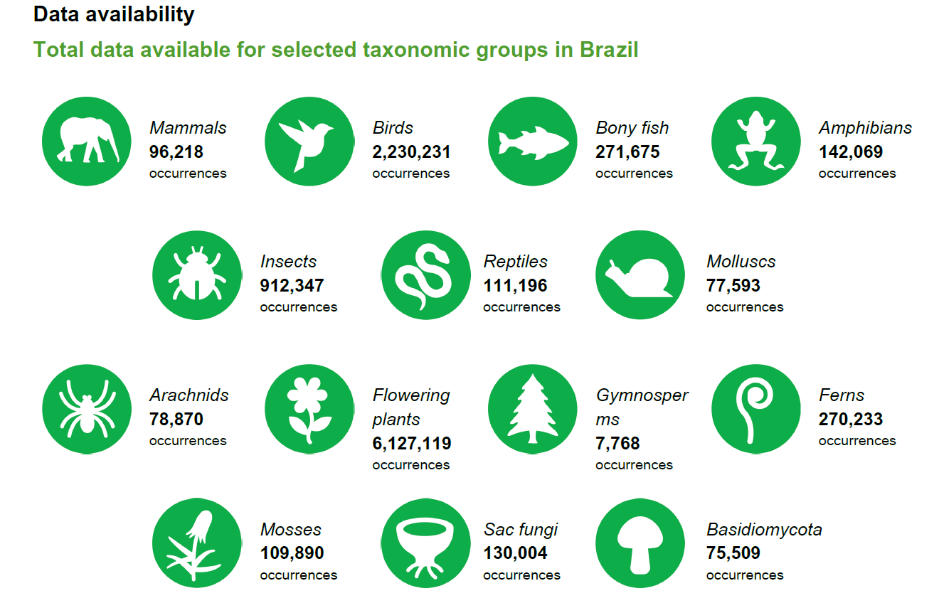
Brazil in GBIF

Slide 15
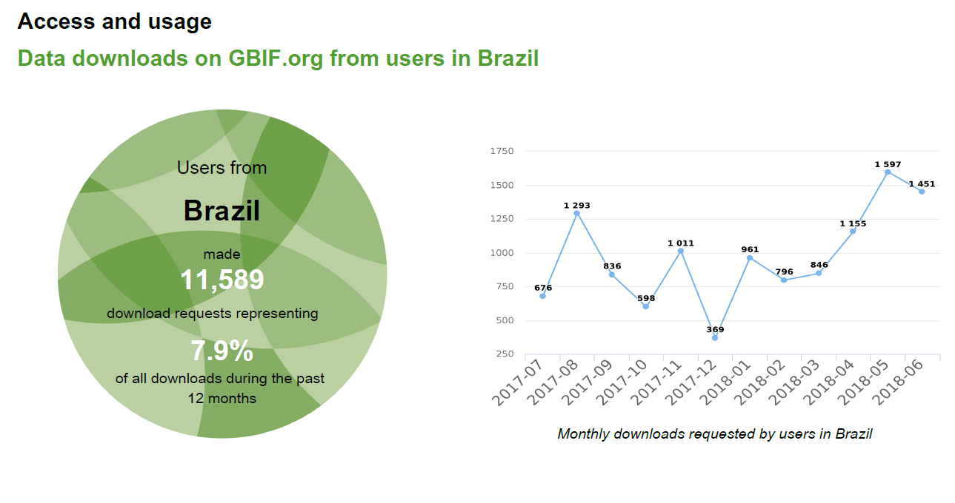
GBIF in Brazil

Slide 16
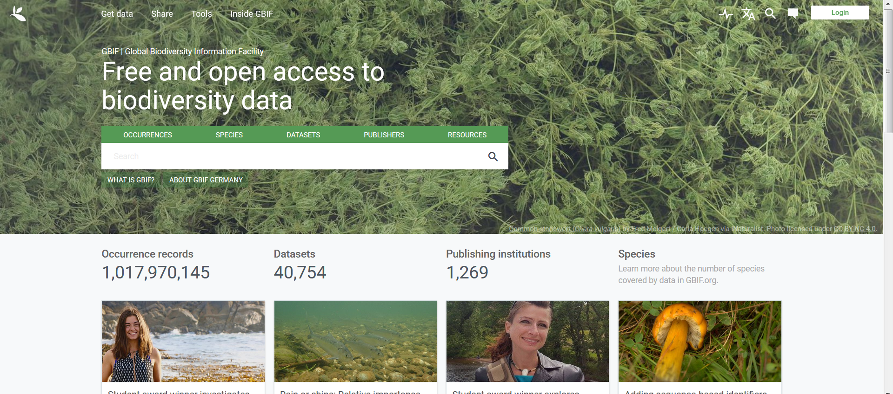
GBIF Online

Slide 17
Hands on!
Which is the taxon with most records in GBIF?
When was the first record collected in Germany?
What are the major contributing databases in Germany?
What are the major basis of record in GBIF
How many records of plants were added from above 6000 meters elevation?
How many records are there for your taxon of interest?
www.gbif.org

Slide 18
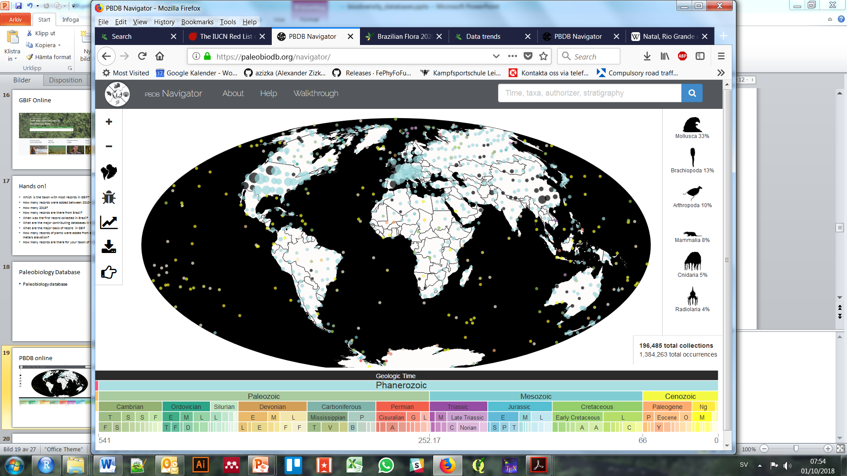
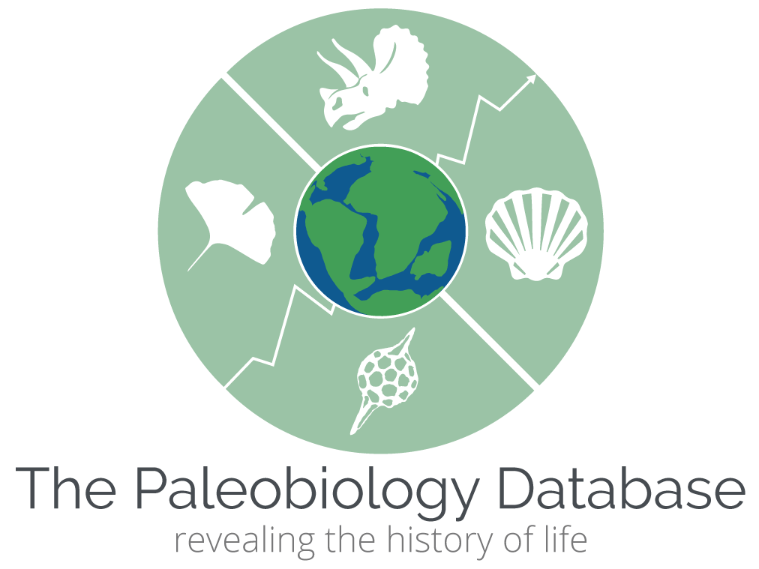
Paleobiology Database (PBDB)

Slide 19
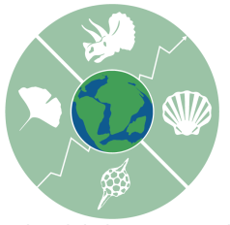
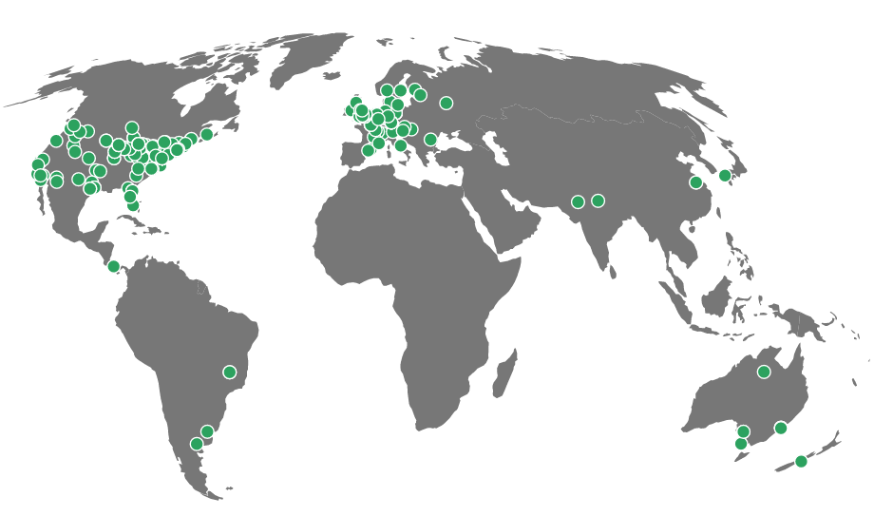
What is PBDB?

Slide 20
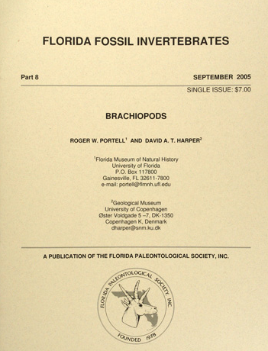
Data in PBDB

Slide 21
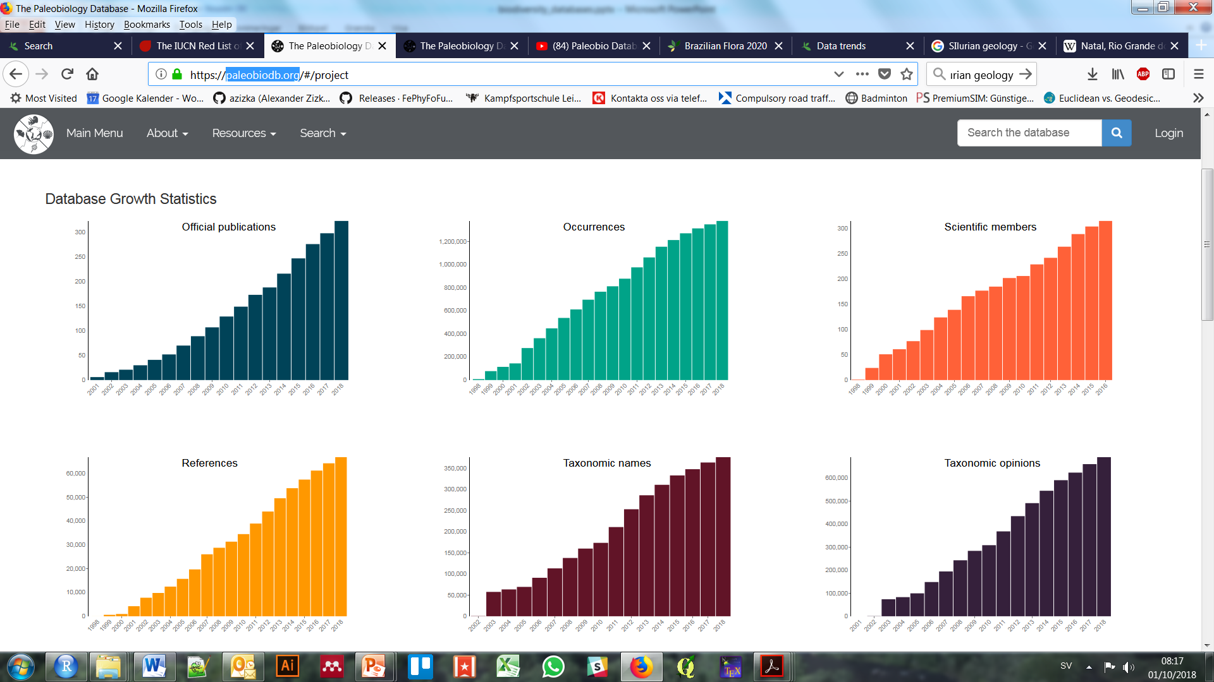
Records

Slide 22
Taxa

Slide 23
PBDB online

Slide 24
Hands on!
How many records are there in PBDB?
Which is the most common taxon?
Where are most records from globally?
How many records are there from the Paleogene?
From which period is the oldest German fossil?
What is the closes (reasonably identified) fossil to Berlin?
www.paleobiodb.org

Slide 25
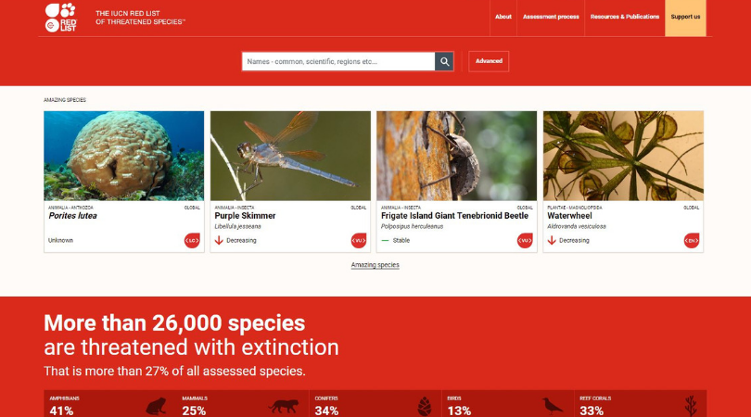
International Union for the Conservation of Nature Red lists

Slide 26
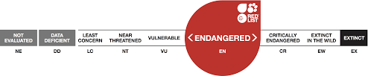
Threat
Threat of extinction for > 90,000 species
Most complete amphibians, birds, mammals

Slide 27
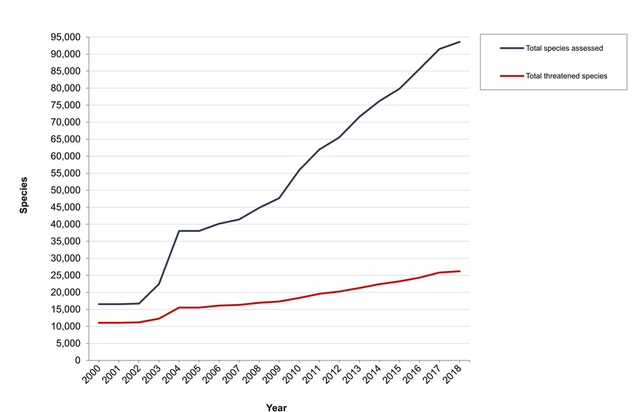
Threat
Threat of extinction for >90,000 species
Most complete amphibians, birds, mammals

Slide 28
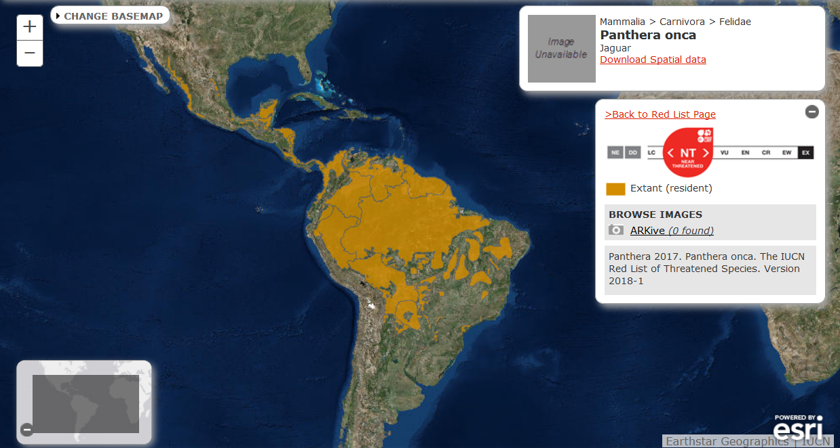
Spatial data

Slide 29
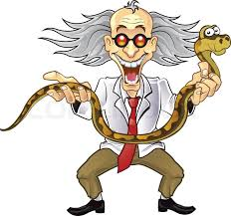
Data in IUCN
Based on:
Populations size
Population dynamics
Species occurrence records
Habitat
Expert knowledge

Slide 30
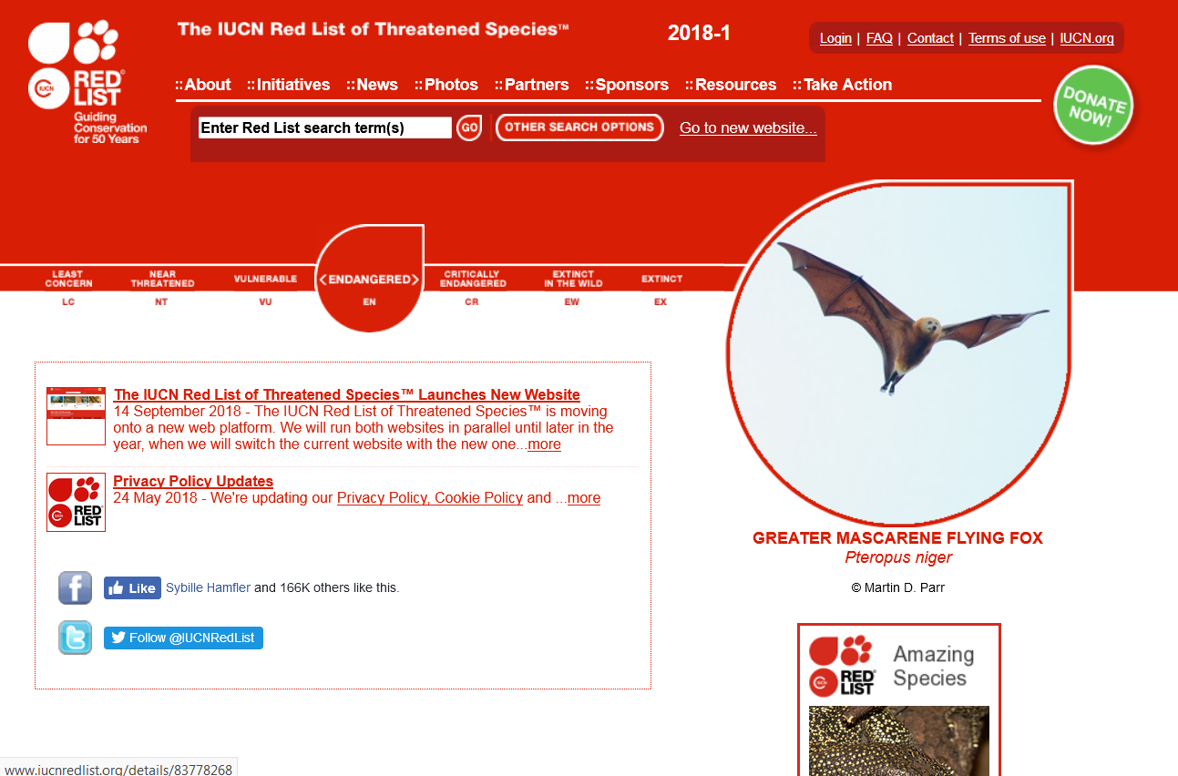
IUCN red list online

Slide 31
Hands on!
How many threatened species are there in Germany?
How many threatened species are there in your group of interest?
What are the major threats to the Iberian lynx (Lynx pardinus)?
www.iucnredlist.org
For plants, check also http://www.bgci.org/threat_search.php

Slide 32
www.gbif.org
www.idigbio.org/
www.ebird.org/
www.splink.cria.org.br
www.birdlife.org/
www.theplantlist.org/
www.tnrs.iplantcollaborative.org/
www.africanplants.senckenberg.de/root/index.php

